Slide 1
Twist Polynomials of Delta-Matroids
By: Lozinskiy Leon, Yuschak Daniel

Slide 2
Why Delta-Matroids?
Matroids are often thought of as generalizations of graphs.
Replacing the matroid axioms with the more general symmetric exchange axiom, gives rise to interesting connections in ribbon graph theory.
They can be found hidden in the following: Column spaces, Skew-Symmetric Matrices, Adjacency Matrix, Graphs in Surfaces, Eulerian Circuits, Grafts, Matchings, and the Greedy Algorithm.

Slide 3
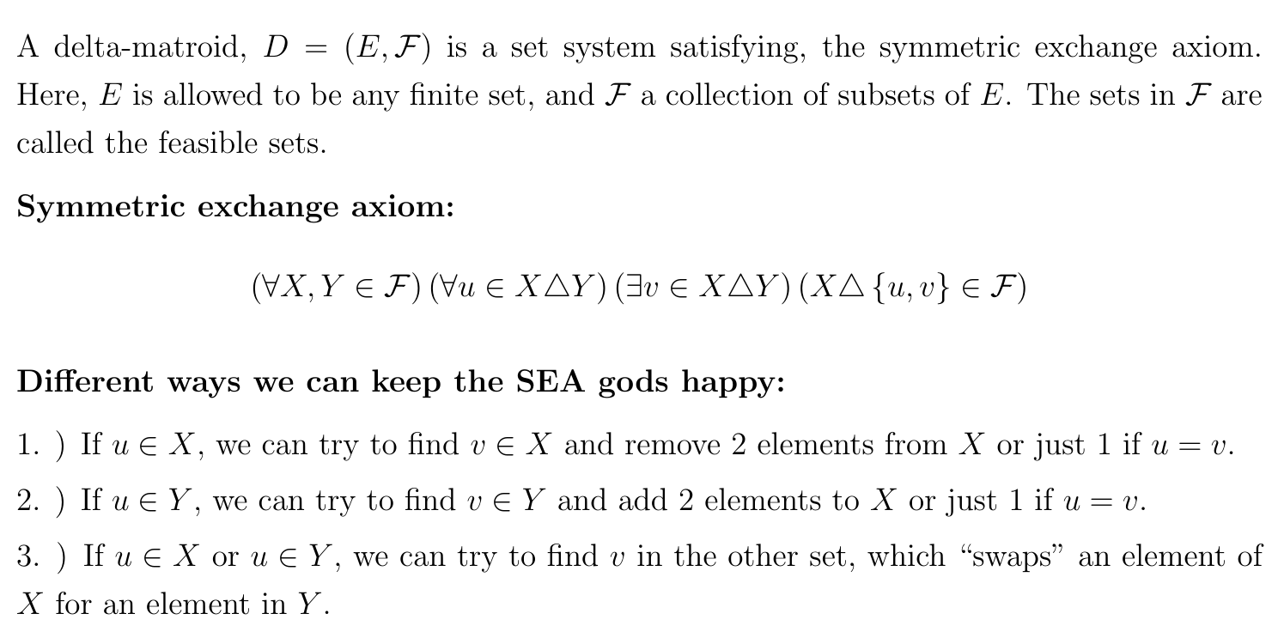
Recap: What is a Delta-Matroid?

Slide 4
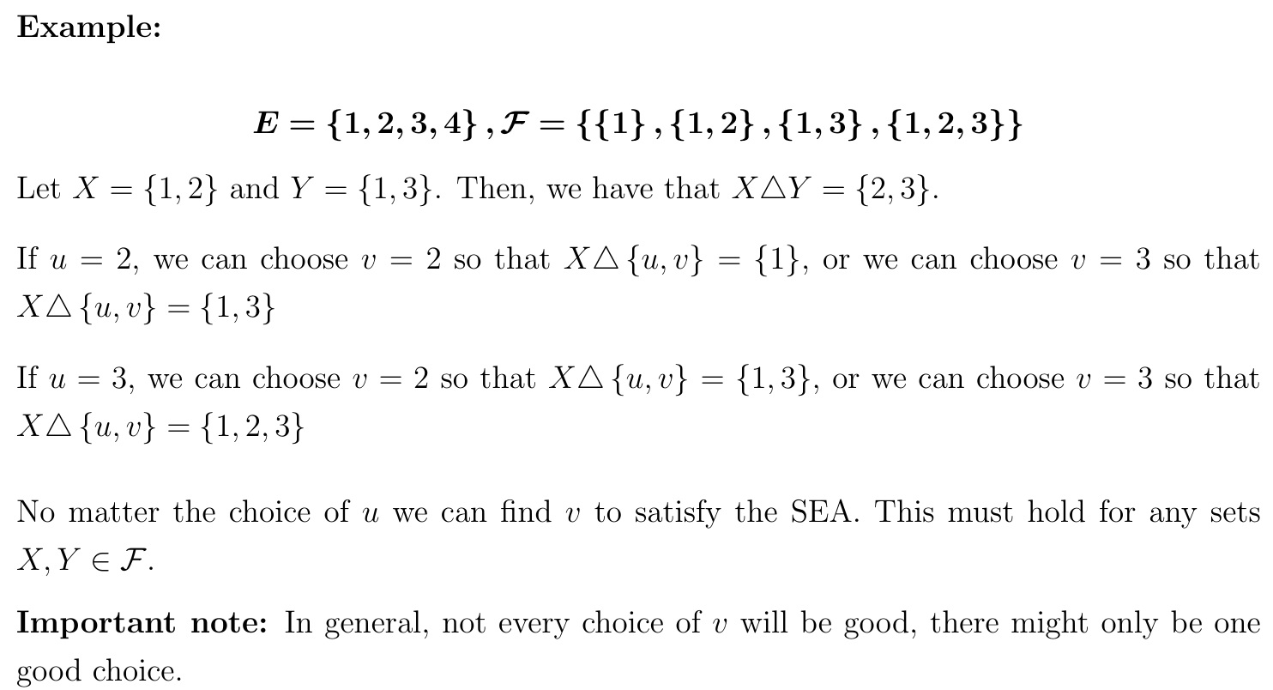
Example!

Slide 5
Loops and Coloop

Slide 6
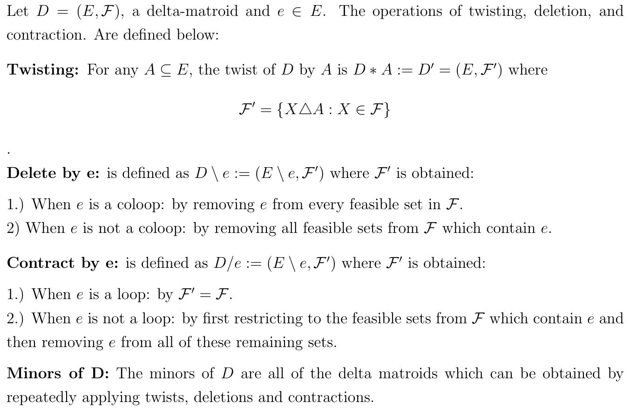
The Three Fundamental Operations

Slide 7
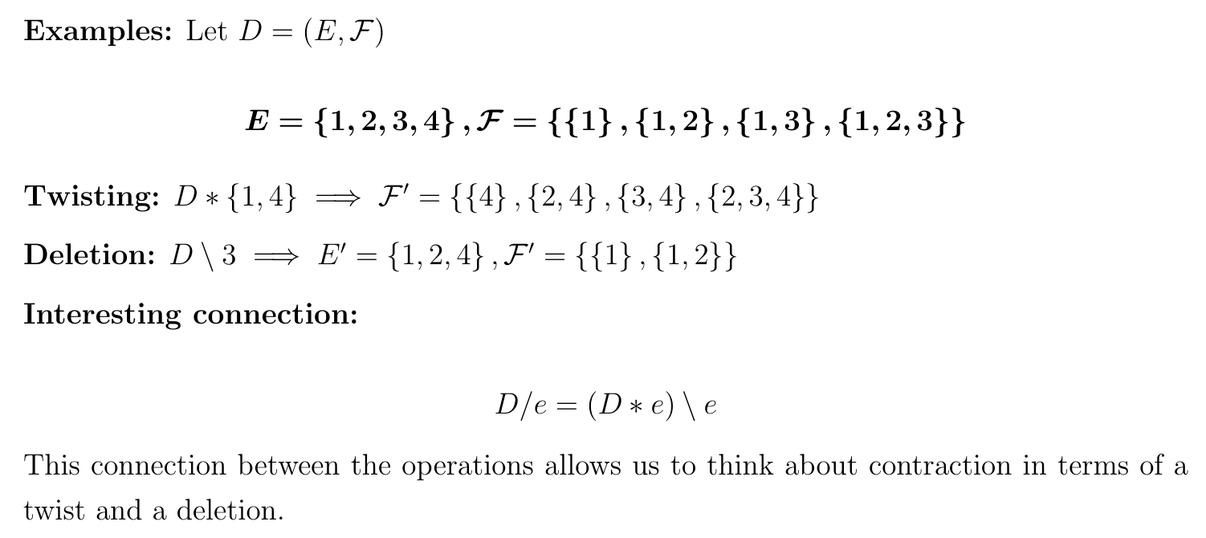
More Examples!

Slide 8
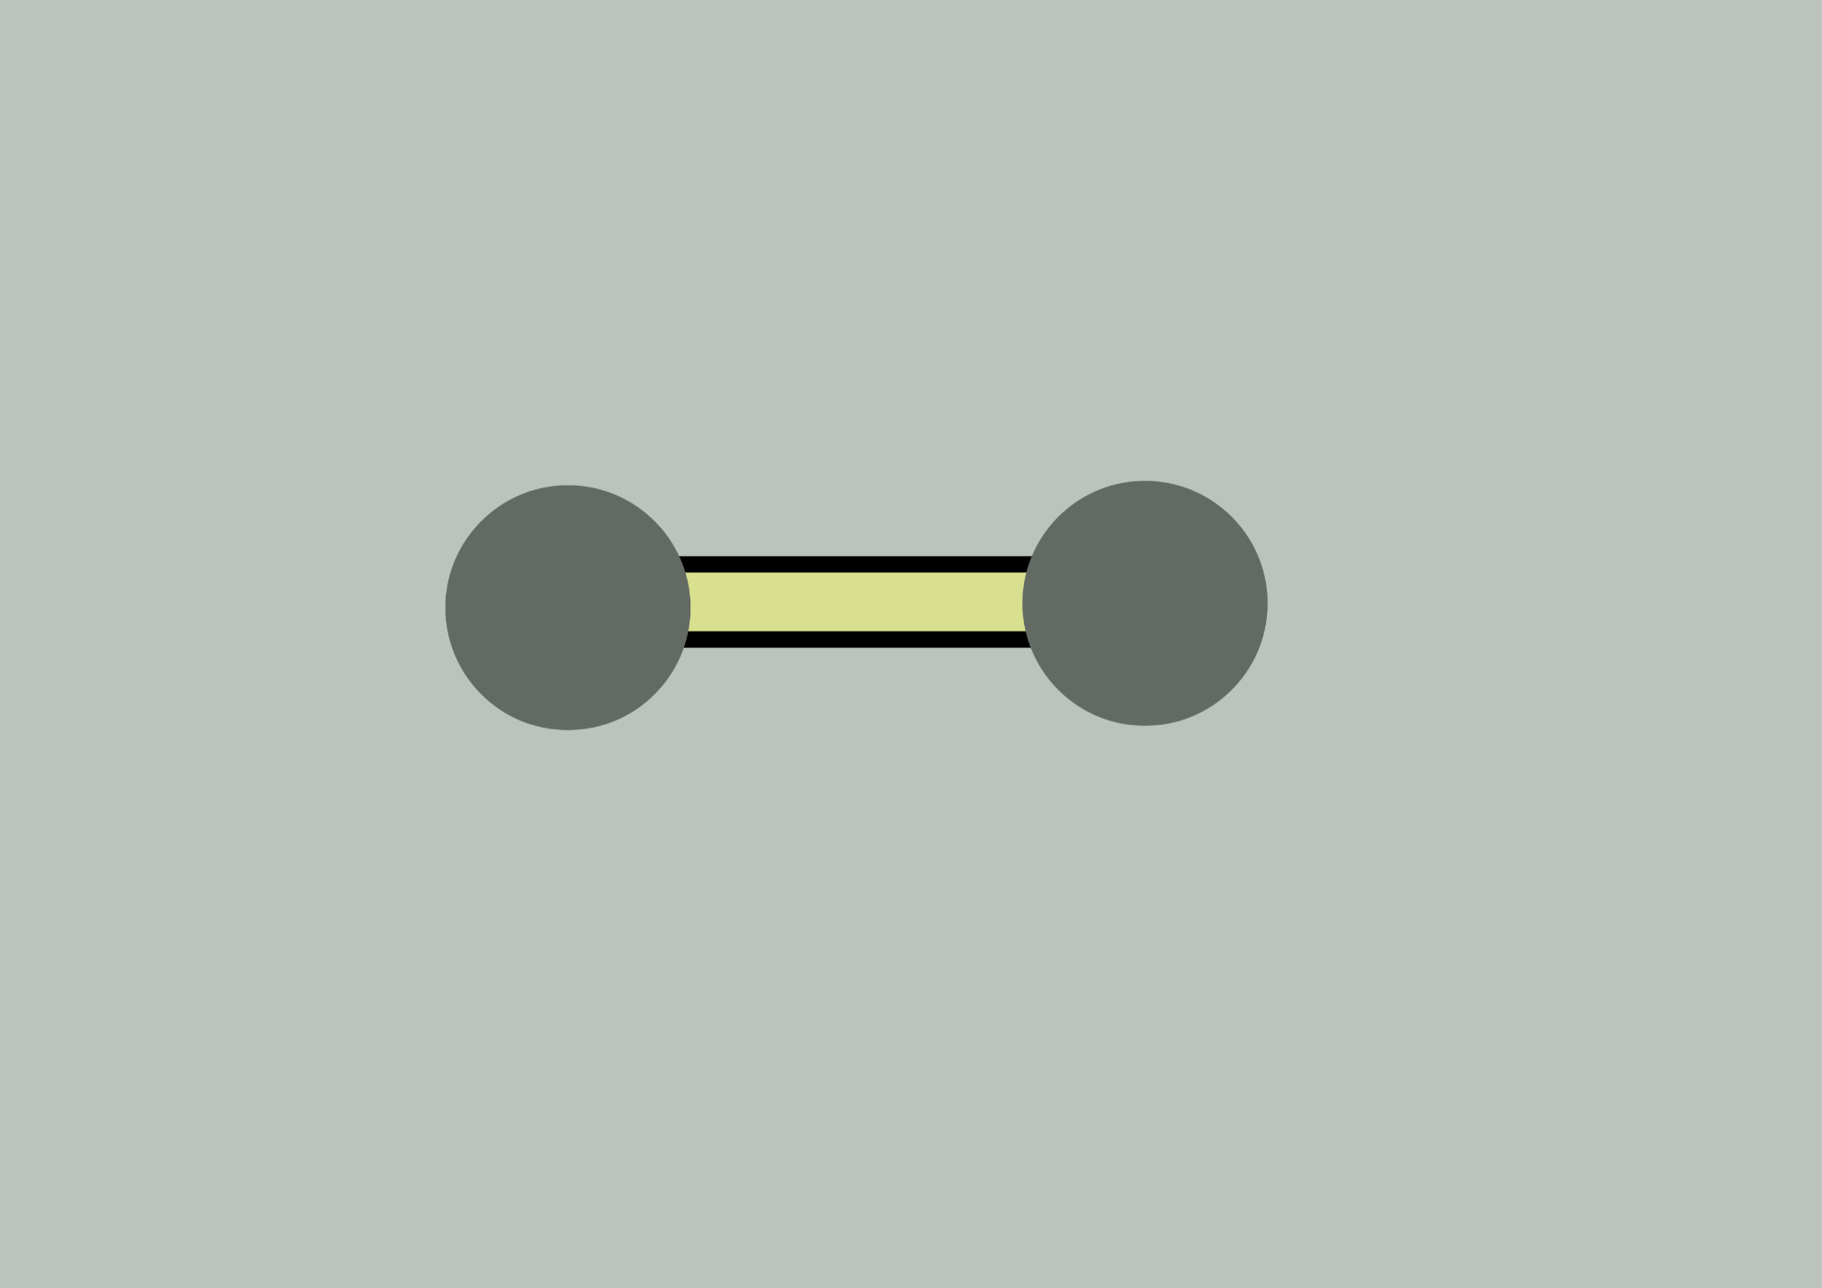
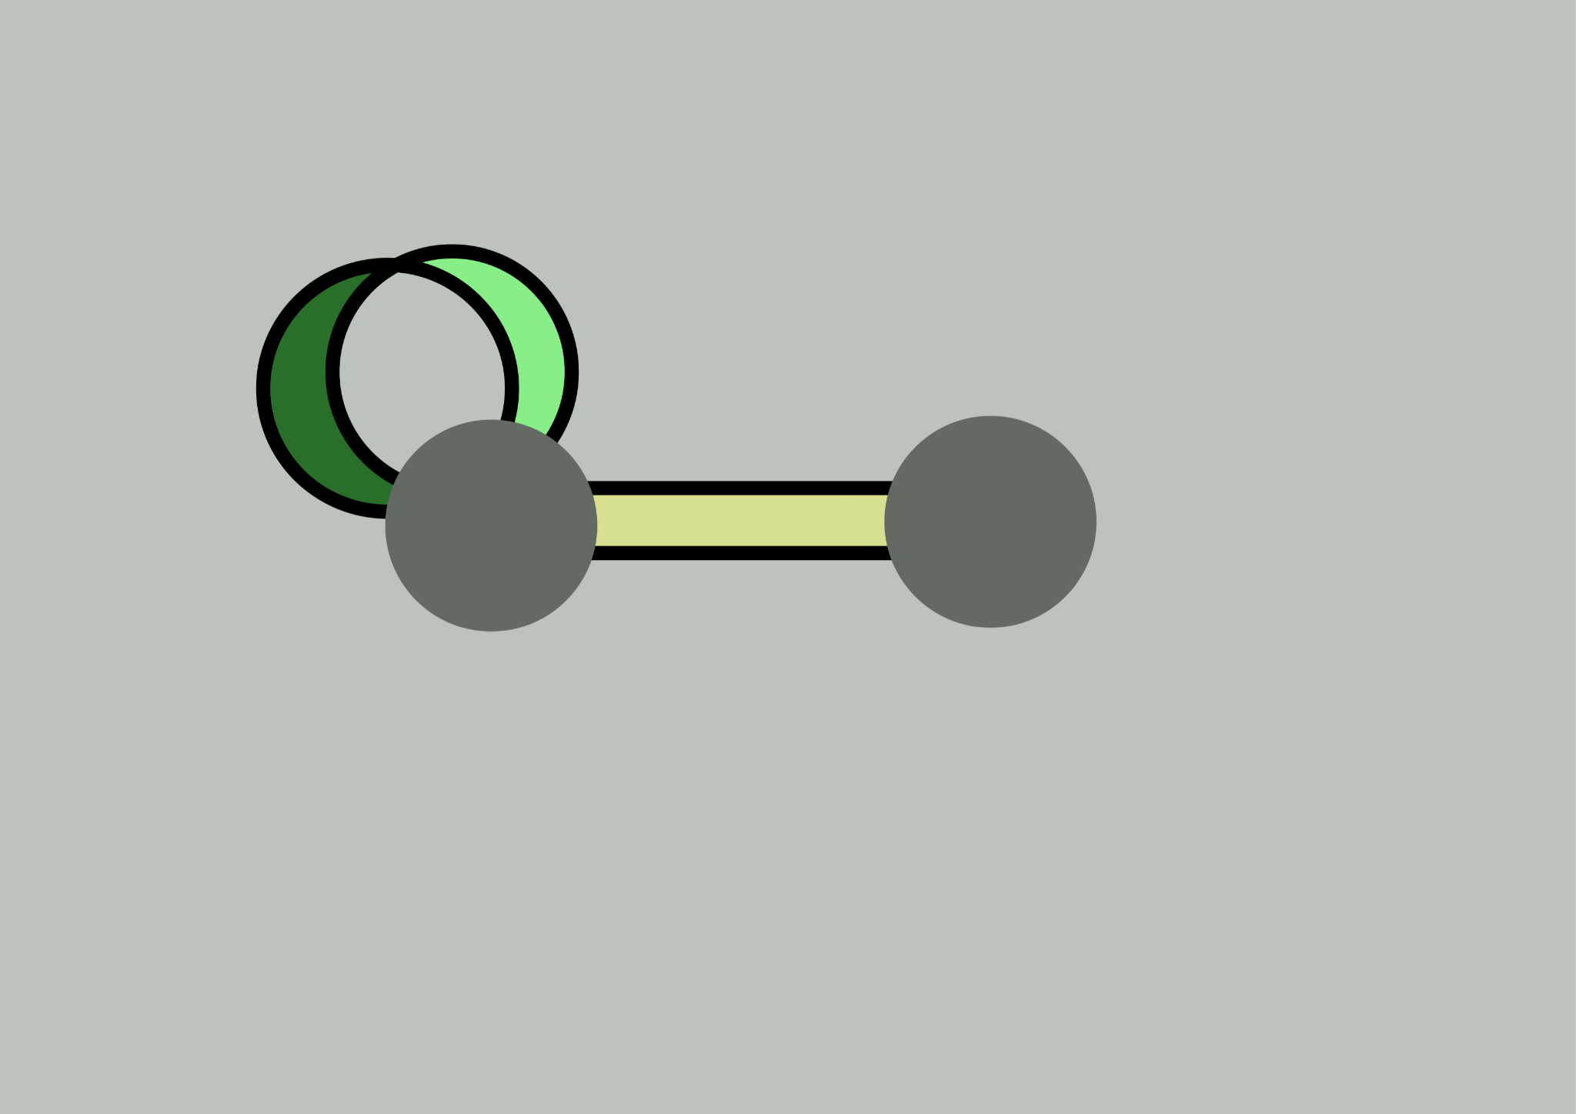
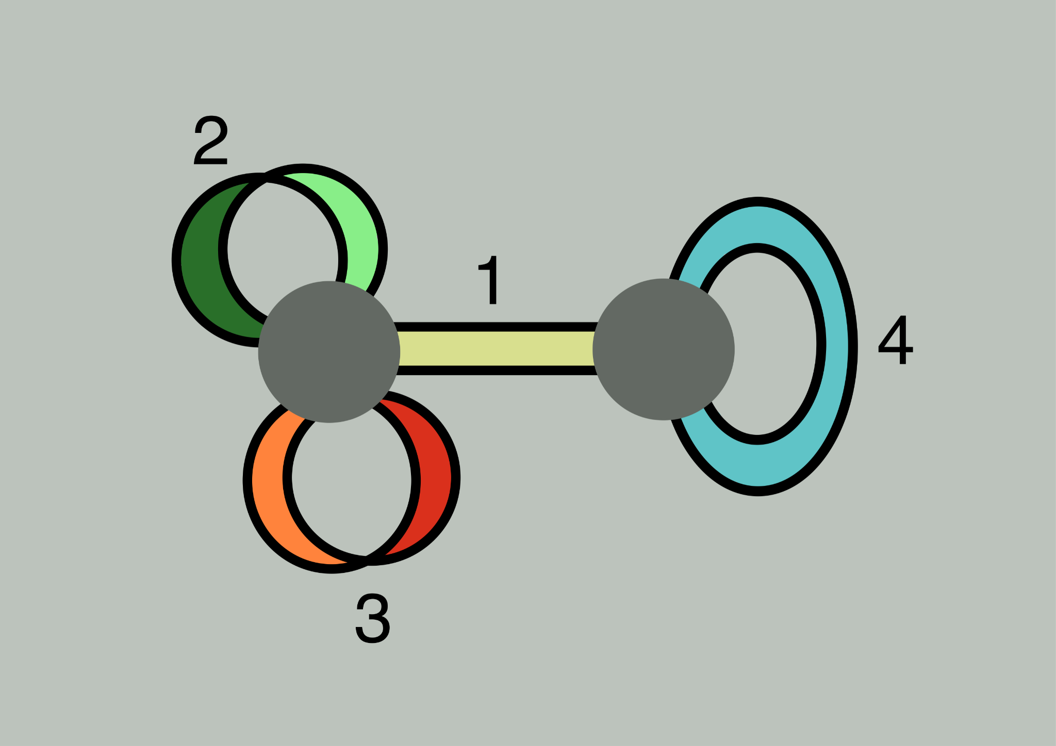
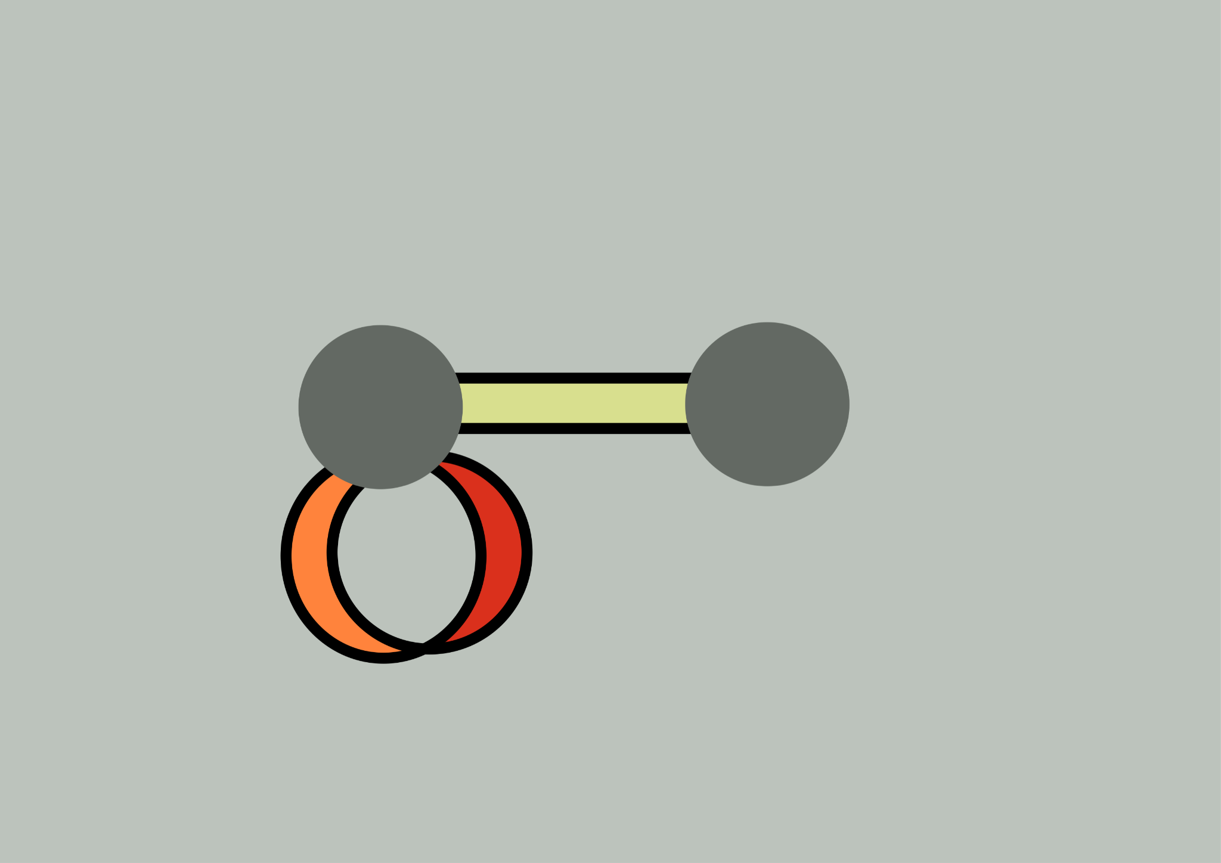
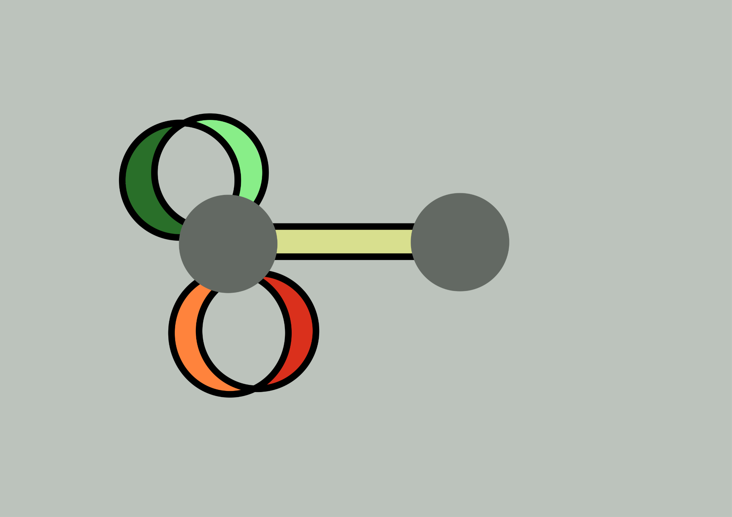
Ribbon-Graphic Delta-Matroids

Slide 9
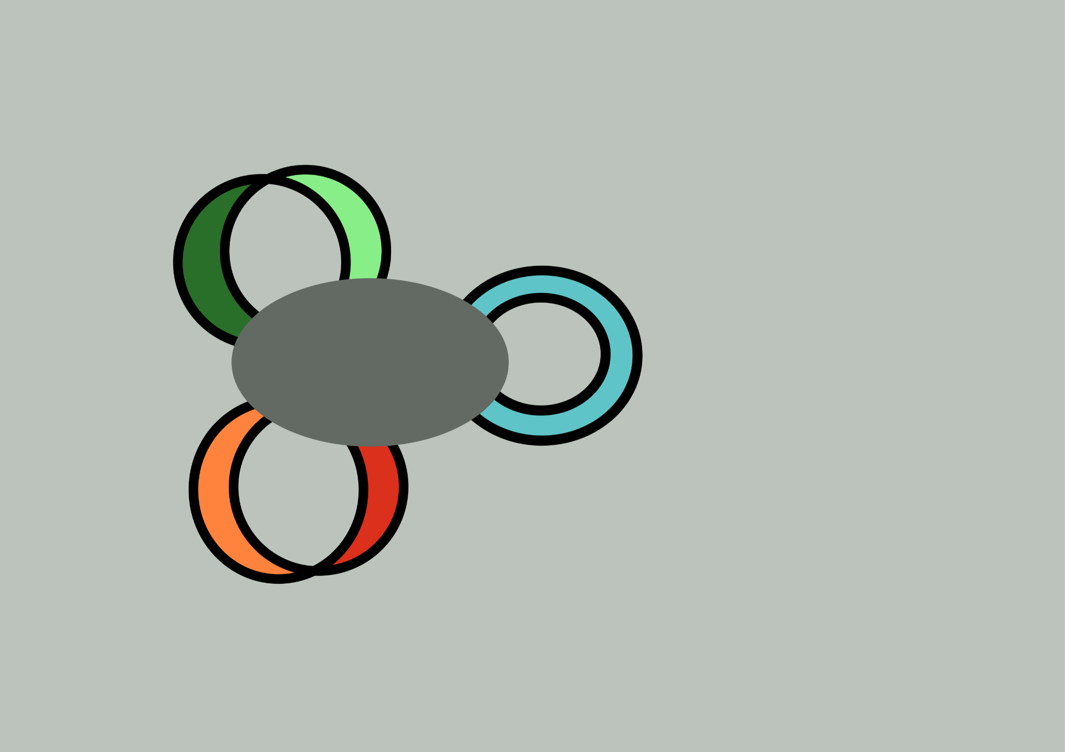
Consistency!

Slide 10
Binary Delta-Matroids

Slide 11
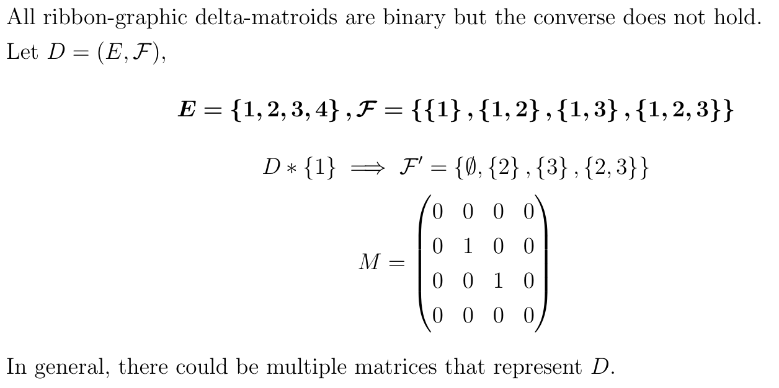
Another Example!

Slide 12
Twist Polynomials

Slide 13
Consequences of Having a Twist Monomial
Assume D is a normal delta-matroid and that w(D) = w(D*e) = m
Suppose {e} ∈ D
∅ ∈ D*e
min size in D*e = 0, max size in D*e = m
For any F ∈ D of size m, e ∈ F
Conclusion: {e} ∈ D ⇒ ∀F ∈ D_{max} e ∈ F

Slide 14
Consequences of Having a Twist Monomial
Assume D is a normal delta-matroid and that w(D) = w(D*e) = m
Suppose {e} ∉ D
∅ ∉ D*e, {e} ∈ D*e
min size in D*e = 1, max size in D*e = m+1
There is some F ∈ D s.t. |F| = m and e ∉ F
Conclusion: {e} ∉ D ⇒ ∃F ∈ D_{max} e ∉ F

Slide 15
Other Consequences (Yan and Jin)
By also considering D*{e, f} and using some implications of SEA, it follows that
{e} ∈ D, {f} ∉ D ⇒ {e, f} ∉ D
{e} ∈ D, {f} ∈ D ⇒ {e, f} ∈ D

Slide 16
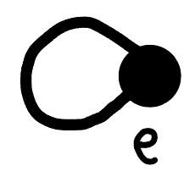
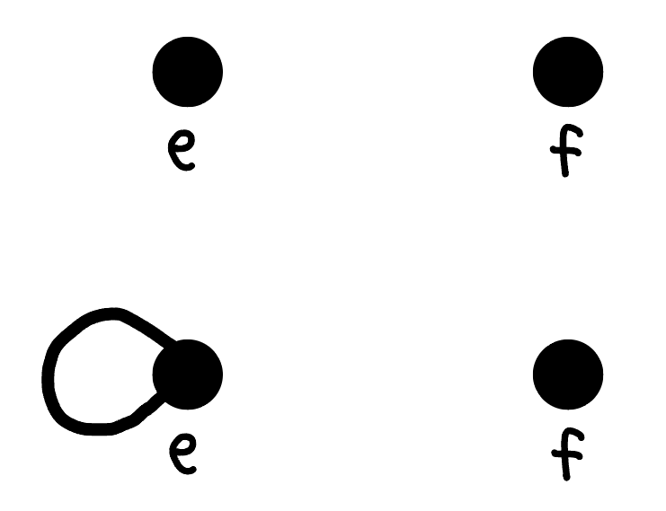
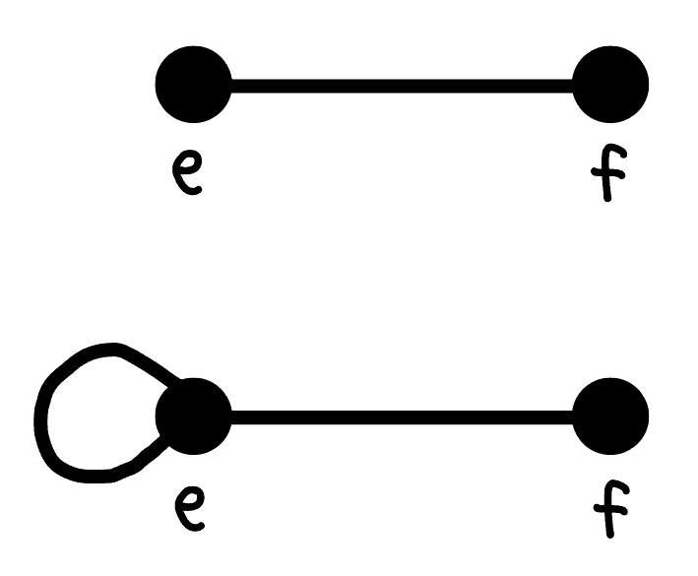
Constructing the Looped Simple Graph of a Binary Delta-Matroid
{e} ∉ D
{e} ∈ D
Label the vertices with elements of E
A vertex e is looped iff {e} ∈ D
INCORRECT: Two vertices e, f are connected with an edge iff {e, f} ∈ D
CORRECT:
When at least one of e, f is unlooped:
e, f are connected with an edge iff {e, f} ∈ D
When both of e, f are looped:
e, f are connected with an edge iff {e, f} ∉ D
{e, f} ∉ D
{e, f} ∈ D
{e, f} ∉ D
{e, f} ∈ D

Slide 17
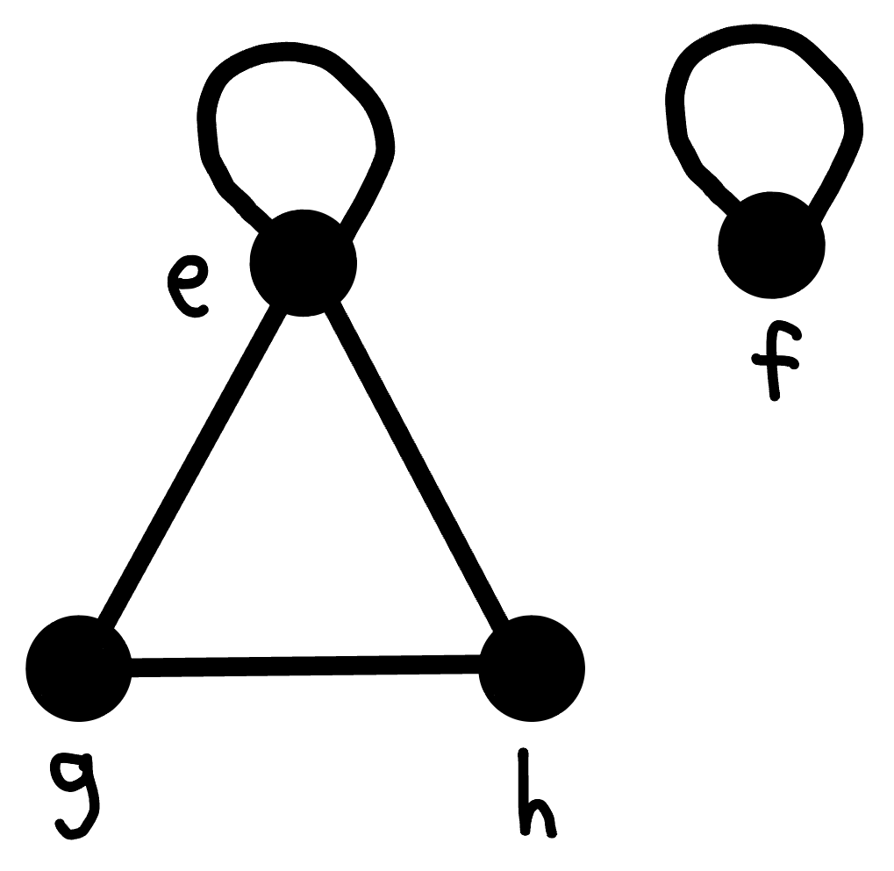
Example
The binary delta-matroid
{∅, {e}, {f}, {e, f}, {e, g}, {e, h}, {g, h}, {e, f, g}, {e, f, h}, {e, g, h}, {f, g, h}, {e, f, g, h}}
has the following looped simple graph

Slide 18
Consequences for Looped Simple Graphs
{e} ∈ D, {f} ∉ D ⇒ {e, f} ∉ D
e is a looped vertex
f is an unlooped vertex
⇒ e and f aren’t joined by an edge
{e} ∈ D, {f} ∈ D ⇒ {e, f} ∈ D
e and f are looped vertices
⇒ e and f aren’t joined by an edge
So, any looped vertex isn’t connected to any other vertices

Slide 19
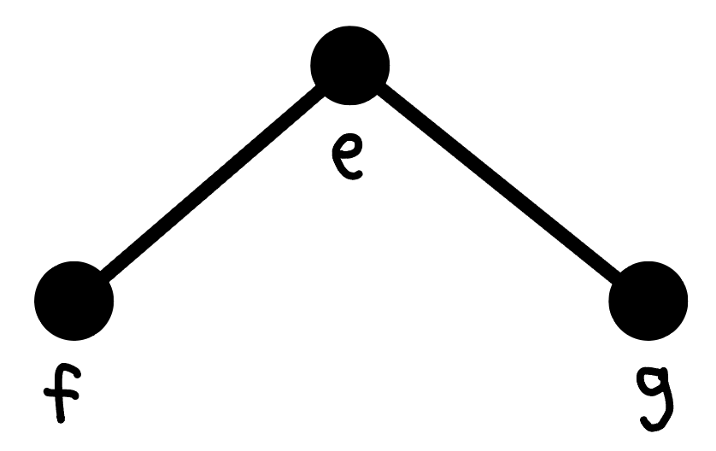
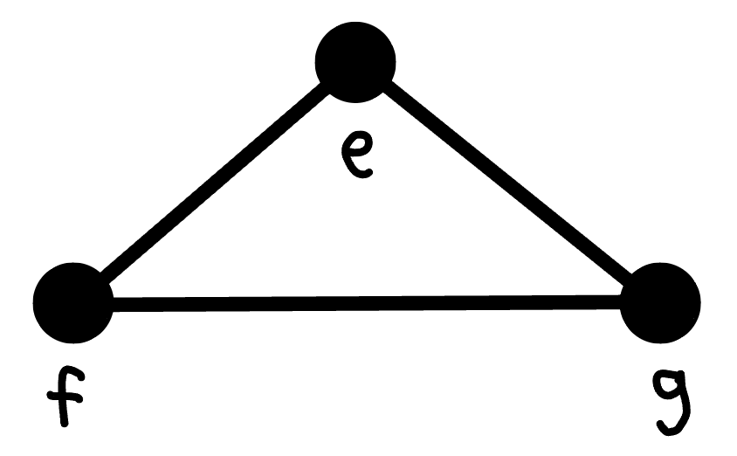
One More Consequence of Having a Twist Monomial
{e}, {f}, {g} ∉ D
{e, f}, {e, g} ∈ D
⇒ {f, g} ∈ D
⇒

Slide 20
Consequences for Looped Simple Graphs
So, the looped simple graph of a binary delta-matroid with a twist monomial must be a disjoint union of single loops and unlooped complete graphs
Yan and Jin also show that each of the complete graphs must have an odd number of vertices, and that this precisely characterizes binary delta-matroids with twist monomials

Slide 21
What about nonbinary delta-matroids with twist monomials?
There are none

Slide 22
Banned Restrictions of Monomial Delta-Matroids
{e} ∈ D, {f} ∈ D ⇒ {e, f} ∈ D
Equivalently, D \ ({e, f}^{c}) ≠ {∅, {e}, {f}}
D \ ({e, f}^{c}) is called the “restriction” of D to {e, f}
So if D is normal and has a twist monomial, then {∅, {e}, {f}} isn’t a restriction of D

Slide 23
Excluded Minor Theorem for Binary Delta-Matroids (Bouchet and Duchamp)
A delta-matroid is binary if and only if no minor of it is isomorphic to any of the following 5 delta-matroids:
E = {1, 2, 3}
{∅, {1, 2}, {1, 3}, {2, 3}, {1, 2, 3}}
{∅, {1}, {2}, {3}, {1, 2}, {1, 3}, {2, 3}}
{∅, {2}, {3], {1, 2}, {1, 3}, {1, 2, 3}}
E = {1, 2, 3, 4}
{∅, {1, 2}, {1, 3}, {1, 4}, {2, 3}, {2, 4}, {3, 4}}
{∅, {1, 2}, {1, 4}, {2, 3}, {3, 4}, {1, 2, 3, 4}}

Slide 24
Lemma Relating Restrictions and Minors
Suppose M and D are normal delta-matroids, and that M is a minor of D
Then M is a restriction of some normal twist of D

Slide 25
Banned Minors of Monomial Delta-Matroids
No restriction of D is isomorphic to {∅, {e}, {f}}
D is normal and has a twist monomial ⇒
D is normal and has a twist monomial ⇒
D is normal and has a twist monomial ⇒
No restriction of any normal twist of D is isomorphic to {∅, {e}, {f}}
No minor of D is isomorphic to {∅, {e}, {f}}

Slide 26
If-Then Conditions That Become Excluded Minor Conditions
{e} ∈ D, {f} ∉ D ⇒ {e, f} ∉ D
{e} ∈ D, {f} ∈ D ⇒ {e, f} ∈ D
No minor of D is isomorphic to {∅, {e}, {e, f}}
No minor of D is isomorphic to {∅, {e}, {f}}
{e}, {f}, {g} ∉ D
{e, f}, {e, g} ∈ D
No minor of D is isomorphic to {∅, {e, f}, {e, g}}
⇒ {f, g} ∈ D

Slide 27
Using the Excluded Minor Theorem for Binary Delta-Matroids
Excluding these minors implies that all 5 of the below delta-matroids also cannot be minors of D
E = {1, 2, 3}
{∅, {1, 2}, {1, 3}, {2, 3}, {1, 2, 3}}
{∅, {1}, {2}, {3}, {1, 2}, {1, 3}, {2, 3}}
{∅, {2}, {3], {1, 2}, {1, 3}, {1, 2, 3}}
E = {1, 2, 3, 4}
{∅, {1, 2}, {1, 3}, {1, 4}, {2, 3}, {2, 4}, {3, 4}}
{∅, {1, 2}, {1, 4}, {2, 3}, {3, 4}, {1, 2, 3, 4}}
And so D must be binary

Slide 28
References
I. Moffatt, Delta-matroids for graph theorists, Surveys in combinatorics 2019, 167–220, London Math. Soc. Lecture Note Ser., 446, Cambridge Univ. Press, Cambridge, 2019.
Q. Yan and X. Jin, Twist polynomials of delta-matroids, Adv. in Appl. Math. 139 (2022) 102363.
Q. Yan and X. Jin, Twist monomials of binary delta-matroids, Preprint arXiv:2205.03487v1 [math.CO].
A. Bouchet and A. Duchamp, Representability of ∆-matroids over GF(2), Linear Algebra Appl. 146 (1991), 67–78.

